Slide 1
Ethnic Enclave?
Sex and the Myth of Isolation in
Twentieth-Century Chinese Canadian History
Elise Chenier, Department of History
Simon Fraser University

Slide 3
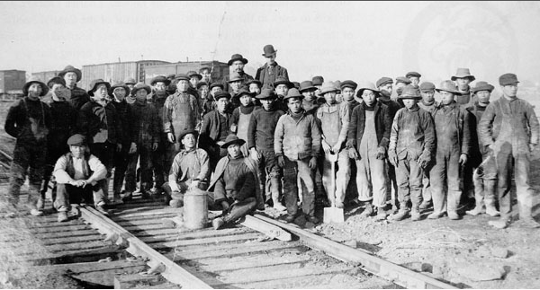
Notes:
The exploitation of the railway worker and those who were forced to pay the head tax have become symbols of these two aspects of our history.
Mostly about men because:
a) it was mostly men who were in Canada at the time
b) the purpose of history has been to show the important contributions people of Chinese heritage have made to the creation of the Canadian nation
c) these contributions tend to be about the railroad, restaurants and laundries.

Slide 4
Notes:
Head Tax Certificate showing that Wong Wai, a native of Hong San, arrived in Victoria on May 20, 1913, and paid the head tax of $500

Slide 5
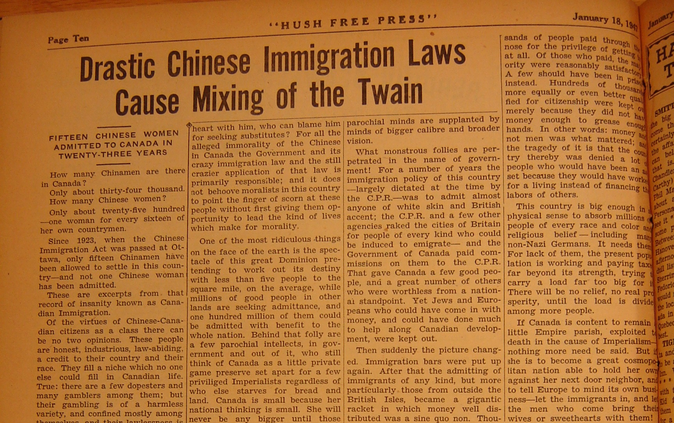

Slide 7
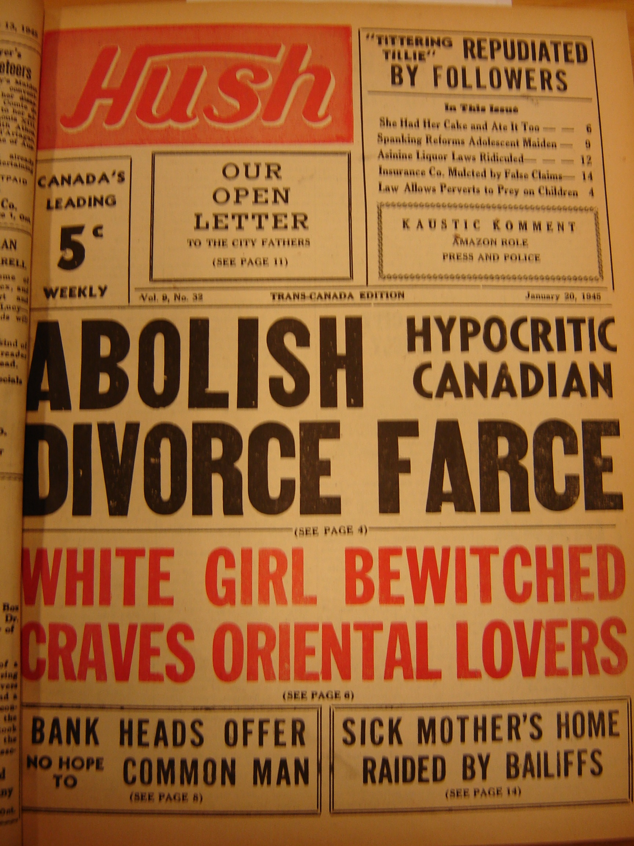
Notes:
Found this in my early research on the Continental Bar
-show images of the bar and items about the Chinese from the papers
-want to know more about this from the perspective of Chinese people

Slide 8
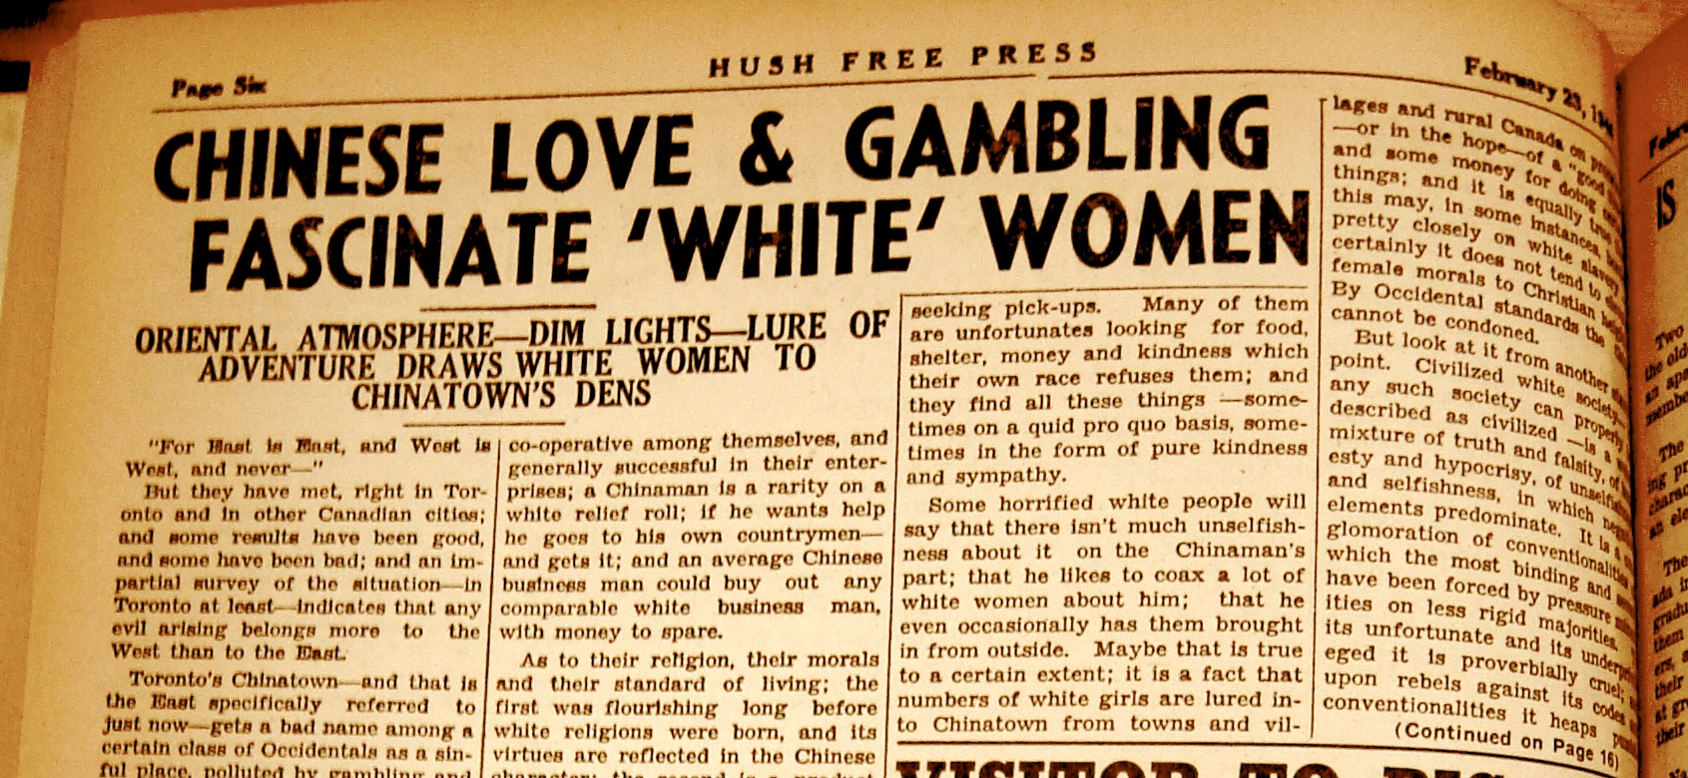

Slide 9
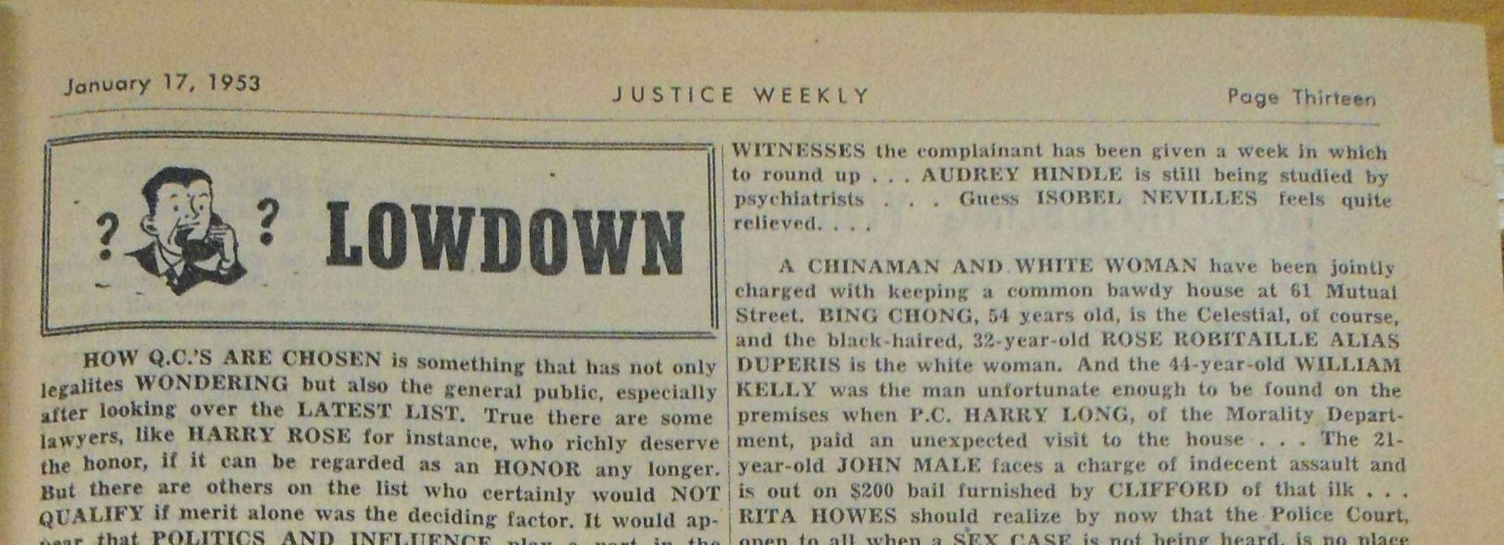
Notes:
From Velma Demerson to the hookers:
Reading the tabloids for evidence of lesbians was how I came across these stories
Alfie Yip describes the Continental
Keith Lok describes his father timing the sex workers (and a story about my technology not working)
Gilbert Chu describes his mother, after Brad mentions Velma (story about hiring Asian men to do the interviews)
Anonymous: sold to a Chinese father for $500, arranged by Alfie’s father

Slide 10
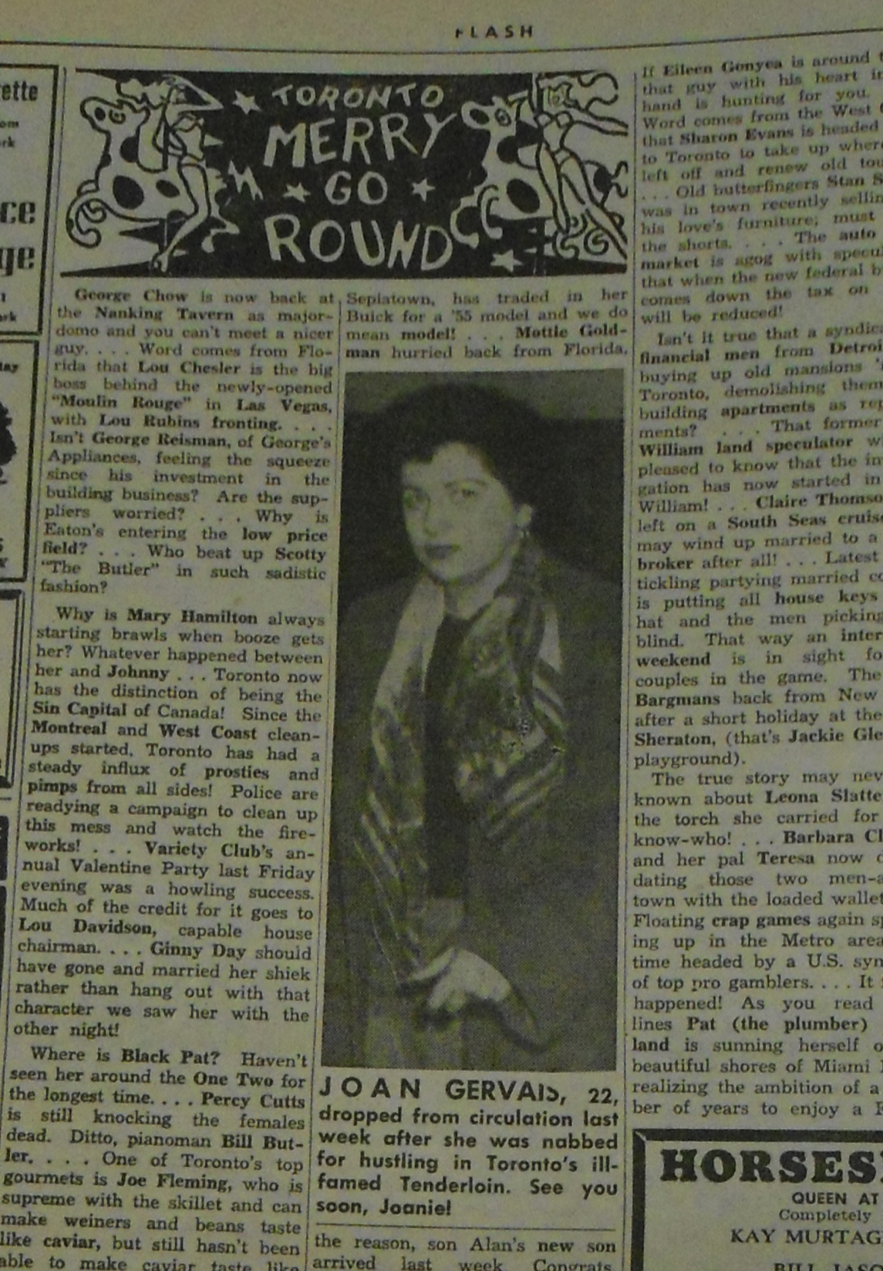

Slide 11

Mavis Garland
Ethel Nealon &
Henry Chu
Notes:
http://vimeo.com/42236421

Slide 12
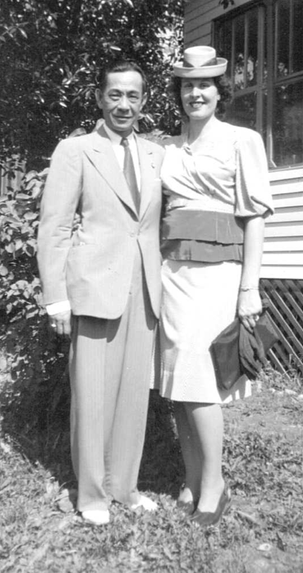
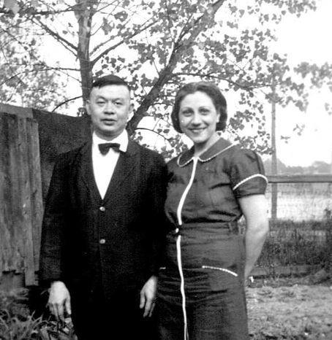
Stanley and Rosalie Chu
D.Y, Chu and his wife
Notes:
DY Chu and his wife
Stanley and Rosalie Chu

